Slide 1
Angular Component Communication
ViewChild and ViewChildren
Lecture 2
By James(Jin) Wang
12/27/2021

Slide 2
Outline
ViewChild
ViewChildren
ViewChild and Angular Forms
ViewChild and ngIf

Slide 3
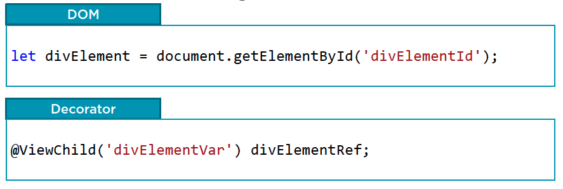
ViewChild
  Getting a Reference

Slide 4
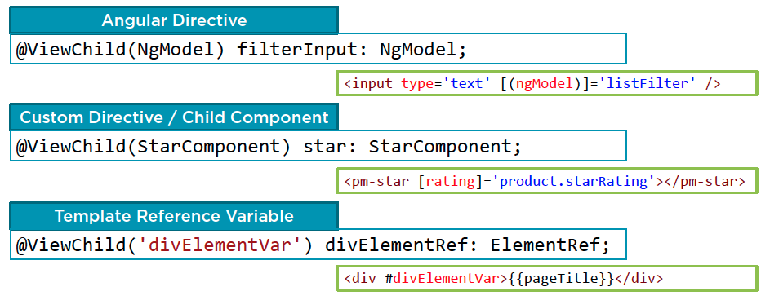
ViewChild
  ViewChild
  Demo: viewChild

Slide 5
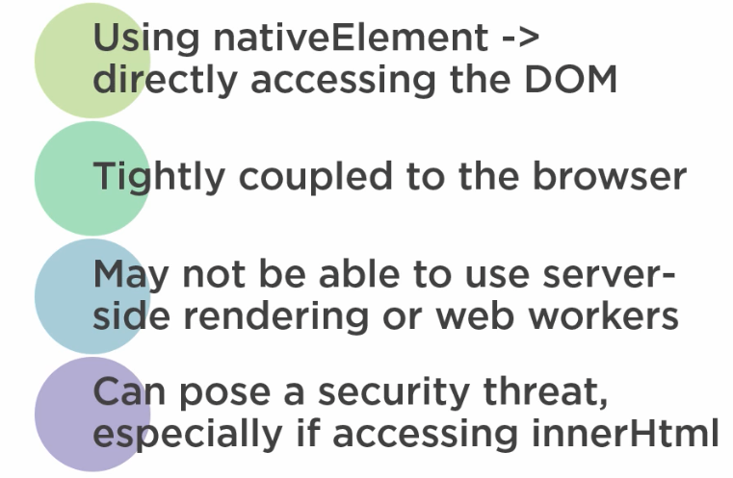
ViewChild
  Considerations When using nativeElement

Slide 6
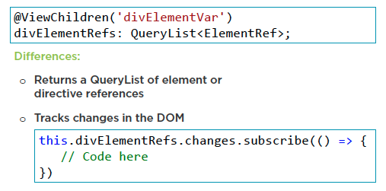
ViewChildren
  ViewChildren

Slide 7
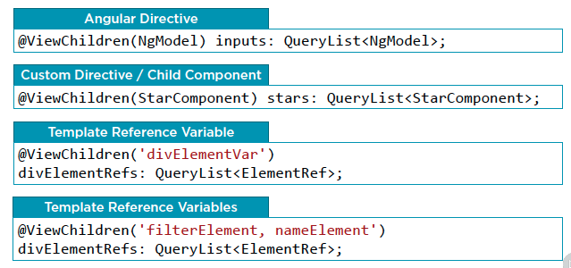
ViewChildren
  ViewChildren
  Demo: viewChildren

Slide 8
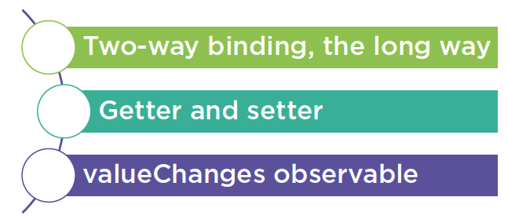
ViewChild and Angular Forms
  Notify Component of user Changes

Slide 9
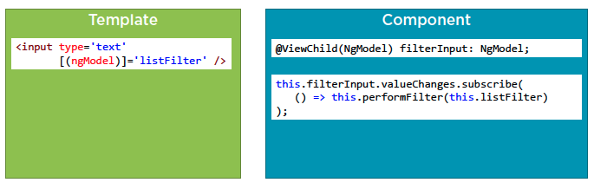
ViewChild and Angular Forms
  ViewChild and Angular Forms

Slide 10
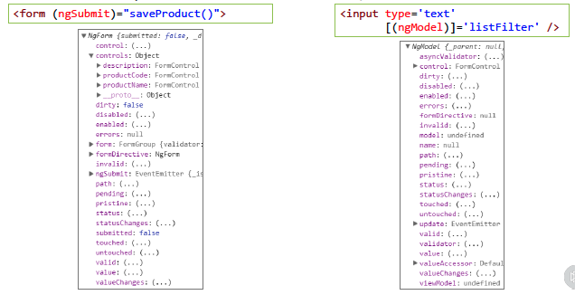
ViewChild and Angular Forms
  Template-driven Forms / No Form
  Demo: viewChild and Angular Forms

Slide 11
Summary

Slide 12
Assignment

Slide 13
Self Study
  Angular Component Communication
  https://app.pluralsight.com/library/courses/angular-component-communication

